Slide 1


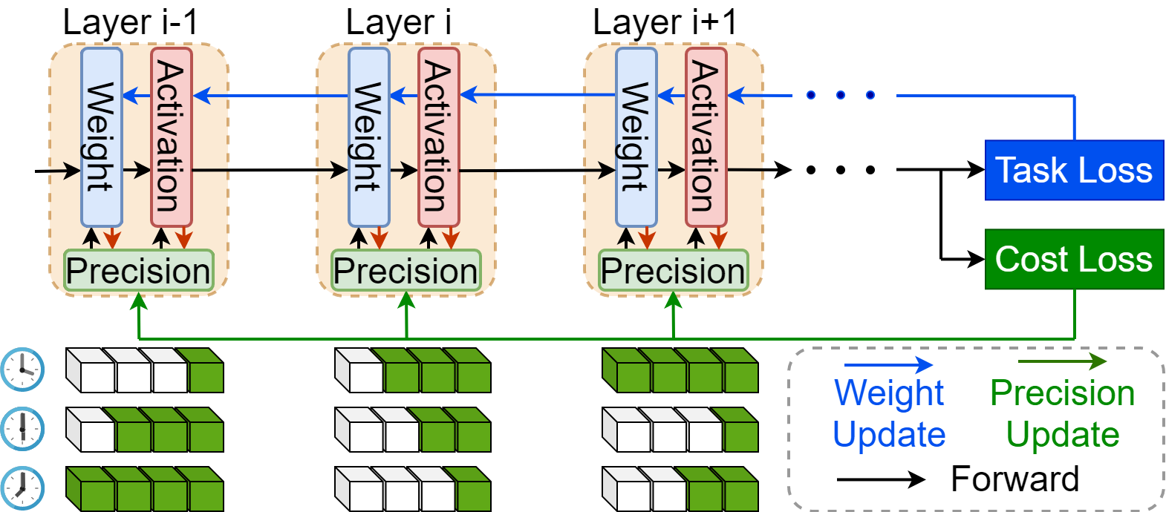
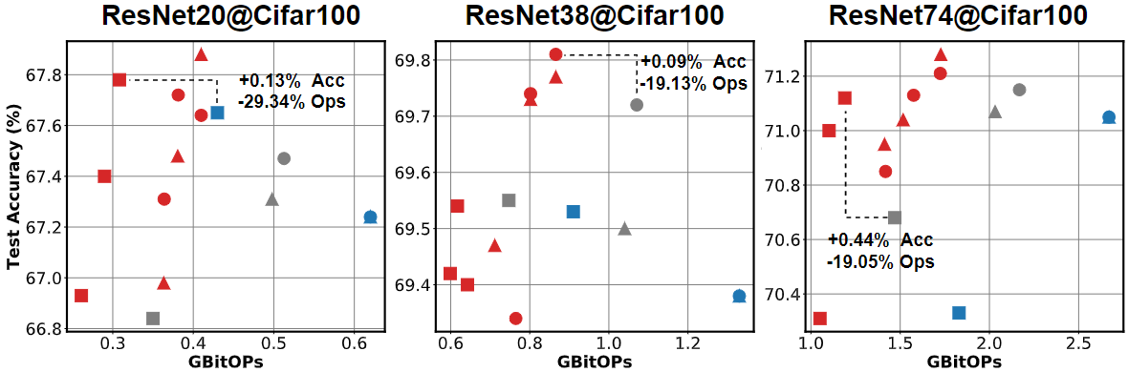




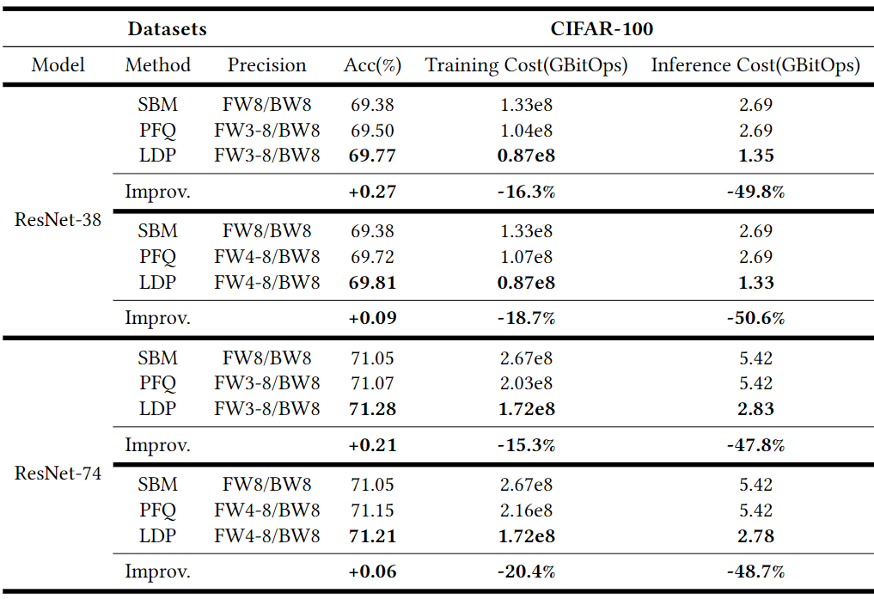




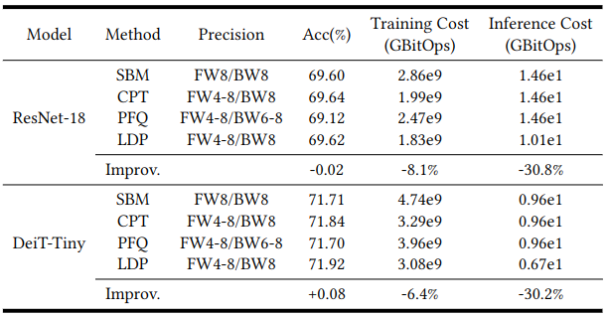
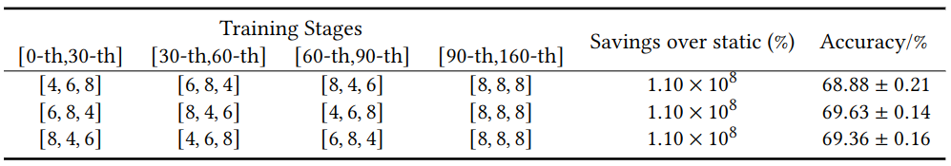
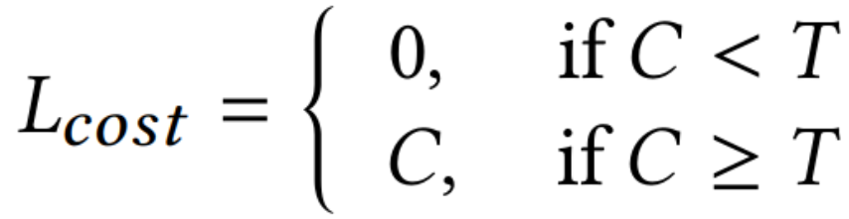
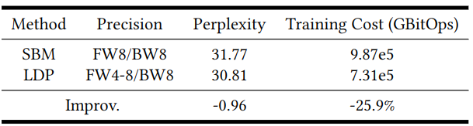

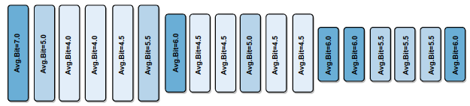
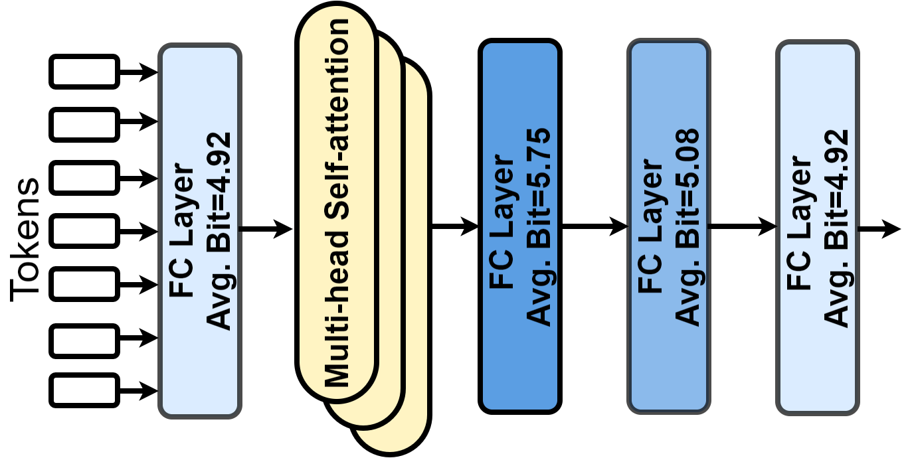



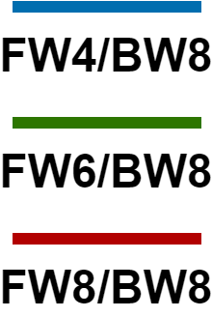
LDP: Learnable Dynamic Precision for Efficient Deep Neural Network Training and Inference
Zhongzhi Yu, Yonggan Fu, Shang Wu, Mengquan Li, Haoran You, Yingyan Lin Rice University
Background and Motivation
Motivating Observations
LDP: Method
Evaluation on CIFAR-100
Deep neural networks’ (DNNs) high performance comes with large DNNs and powerful computers
Deep neural networks (DNNs) are costly:
Prohibitive training cost:
10¹⁸ FLOPs for training ResNet-50@ImageNet
Excessive inference cost:
10⁹ FLOPs for single-image inference with ResNet-50@ImageNet
Is only the temporal dynamic precision enough?
Inspirations from previous works:
Different layers have different sensitivities [C. Zhang, ICML’19] [K. Greff, ICLR’17]
Precision has similar effect as learning rate [Y. Fu, ICLR’20]
Exploration on the importance of spatial and temporal precision allocation
Settings:
Temporal: Change precision at 30, 60, 90 epochs
Spatial: [a,b,c]: Assign a,b,c-bit to first three blocks, respectively
Insights:
Both temporal and spatial precision allocations impact the training accuracy-efficiency trade-off.
Different combination lead to 0.75% accuracy gap.
Powerful computers
Large DNNs
High DNN
performance
Automatically learn the spatial and temporal precision allocation during training
Enabler 1: Differentiable learnable precision
Challenge: How to achieve a differentiable precision learning on top of the discrete precision
Vanilla quantization process:
Use a learnable quantization step with a layer-wise learnable parameter 𝛽
Enabler 2: Loss function design
Challenge: Balance accuracy and efficiency when scales of L_{task} and L_{cost} vary among different tasks and during training
Penalize training cost when exceeding threshold T
Balance each layer’s precision gradient w.r.t. L_{task} and L_{cost}
Spatial dynamic precision allocation
is also important
Growing demand for on-device training & inference
Large DNNs with prohibitive training & inference cost
CIFAR-100： ↑0.44% accuracy, ↓29.34% training cost, ↓50.6% inference cost
Low-precision Method: a promising direction to narrow the gap
ImageNet：↓30.8% inference cost and ↓8.1% training cost with comparable accuracy
Evaluation on ImageNet
Existing Low-precision Methods
Static low-precision training: [S. Banner, NeurIPS’18]
Use same precision during training process
Large accuracy gap under low-precision
Temporal dynamic low-precision training: A promising direction [Y. Fu, NeurIPS’20], [Y. Fu, ICLR’21]
Assign different precisions for different training stages for better accuracy-efficiency trade-off
Only consider temporal dynamic precision
Need extra efforts in hyperparams finetuning
WikiText-103: ↓0.96 perplexity (the lower, the better) with ↓25.9% training cost
How to automatically generate the spatial and temporal precision allocation during training?
Evaluation of Transformer on WikiText-103
Contributions
LDP: Visualization
Learnable dynamic precision (LDP): a framework to automatically learn the spatial and temporal precision allocation during training
Develop a differentiable method to enable end-to-end learnable dynamic precision DNN training
Achieve the SOTA accuracy-efficiency trade-off on seven DNNs, five datasets and three tasks in both training and inference
LDP: Evaluation
Vis. 1: Learned precision is consistent with manual design [J. Shen, AAAI’20] [Y. Wang, ISP’20]
Deeper
Seven models on five datasets from three tasks:
ResNet@CIFAR for image classification
ResNet18/DeiT-Tiny@ImageNet for image classification
PAN@Urban-100 for image super-resolution
Transformer@Wiki-101 for language modeling
Three baselines:
Static low-precision training: SBM [S Banner, NeurIPS’18]
Dynamic low-precision training: PFQ [Y. Fu, NeurIPS’19] & CPT [Y. Fu, ICLR’20]
Higher precision in
Blocks after downsampling
Deep blocks with lowest spatial resolution
Precision
Low
High
Vis. 1: ResNet-38@CIFAR-100 block-wise average precision
Model precision
Model precision
Layer i-1 precision
Layer i precision
Layer i+1 precision
Vis. 2: Learned precision can guide model design
Decreased precision (higher redundancy) in the last two FC layers
Static precision training
Temporal dynamic precision training
Learnable Dynamic Precision Training
Vis. 2： DeiT-Tiny@ImageNet layer-wise average precision
Consistent with the work studying FC layers [J. Guo, arXiv’21]

